Slide 1
Introduction to Prepayment Modeling
August 2014

Slide 2
Agenda
Overview
What is a prepayment model?
The importance of a prepayment model
Topics in Model Fitting
Spline calculations
Fitting the Media Effect
Fitting Credit Availability
Model Improvements
Monotonic Spline Function
Media Effect “Jump Up” Problem
Change Credit Availability
Efficient R- Script
Model Version Review

Slide 3
What is a prepayment model? The importance of a prepayment model
Overview

Slide 4
Prepayment on Residential Mortgages
What is Prepayment
A mortgage is a loan contract with a certain repayment schedule. This schedule will establish a monthly cash flow to payoff the debt. The activities that may accelerate the repayment schedule, resulting in extinguishing the mortgage contract earlier, is called a prepayment.
Mortgage Contract
Establish repayment schedule
Cash Flow
accelerates the repayment schedule
Prepayment
Four kinds of prepayment activities
Curtailment / Full payment: Send more than the scheduled monthly payment
Refinancing: Replaces the mortgage with a new one
Turnover: Prepayment due to sale of home
Default: Borrower fails to make required monthly payments
Prepayment Model Importance
Our Goal
Key
Foundation
MBS Valuation
Estimate Cash Flow
Prepayment Model
Investor in a MBS has a short position in a call option due to the homeowner’s right to prepay, a put option due to the homeowner’s option to default, and also a long position in a non-callable bond. Prepayments alter the cash flow of the MBS and thus its return. So, the key to estimating the value of an MBS is to accurately estimate its cash flow. A decent prepayment model will definitely be the foundation of the cash flow estimation.

Slide 5
What is a Prepayment Model?
Prepayment Model with Sub-components
A prepayment model is a model to describe and predict homeowner prepayment behavior.
We analyze the four kinds of prepayment separately and then combine their influence together.
Prepayment
Activities
Quantitative Prepayment Speed
Refinancing
Curtail
?
Turnover
Default
✓
Measuring Prepayment Rates
Use rates like SMM, CPR and PSA rate to describe the prepayment speed.
SMM converts the dollar amount into prepayment rate per dollar (expressed on a monthly basis)
CPR is the corresponding annual value.
PSA uses a benchmark prepayment curve.

Slide 6
Spline calculations Media Effect Credit Availability
Topics in Model Fitting

Slide 7
Inputs of prepayment model
What inputs does a prepayment model need?
Borrower Characteristics
Factor | Input name | Comments
Credit Score | FICO | Credit Scoring
Input of
Prepayment
Model
Loan Characteristics
Loan Size | ACLS | Average Loan Size
Loan Rate | WAC | Weighted Average Coupon
Loan Age | WALA | Seasoning
Loan Equity | LTV | Loan to Value Ratio
Pool Factor | Burnout | Current to Original Balance Ratio
Macro Economic Variables
Housing Mkt | HPA | Home Price Appreciation
Mortgage Rate | PMMS | Mortgage Rate
Seasonal | SEASON | Market Seasonal Factor
Total SMM = curtailment SMM + default SMM + turnover SMM + refinance SMM
Input Parameter |  | Curt | Dflt | Turn | Refi
Borrower | FICO |  | • |  | •
Loan | ACLS |  |  |  | •
 | WAC |  |  | • | •
 | WALA | • | • | • | •
 | LTV |  | • | • | •
 | Burnout |  |  |  | •
Macro-Economic | HPA |  |  | • | •
 | PMMS |  |  | • | •
 | SEASON |  |  | • | •

Slide 8
Modeling Overview and Structure
Inputs
Curtail
Default
Turnover
Refinancing
Parameter | Method
wala | 1. spline 2. least square optimal
constSMM * cltv * wala * fico
constSMM | 1. subtract Curt smm 2. weighted mean
cltv | 1. bucket WA 2. spline 3. least square optimal
wala
fico
constSMM * wala * incentive *cltv
seasonality | 1. Subtract Curt and Dflt smm 2. Deseasonal
constSMM | 1.weighted mean
wala | 1. bucket WA 2. spline 3. least square optimal
incentive
cltv
constSMM * incentive * wala * burnout * loan size * media * HPA
constSMM | subtract Curt, Dflt and Turn smm
incentive | 1. bucket WA 2. spline 3. least square optimal
wala
burnout
loan size
media effect | media = max(5 * DeltaPMMS30_MA, 1.0)
HPA | HPA = 1 - 0.8/(1+exp((hpa-11%)/3%))
Total SMM = curtailment SMM + default SMM + turnover SMM + refinance SMM

Slide 9
Modeling Methods: Splines I
1.Bucket and Weighted Mean
Raw Data
We can see the data distributed around several small area. The first idea is to transfer the data area into data point.
Data
Area
Data
Point
Difficult to measure
Easy to measure
Bucket
Weighted Mean
Change Y Scale
set up buckets
weight mean along horizontal axis and vertical axis
Change Y scale. Get data point which easy to model.

Slide 10
Modeling Methods: Spline II
2. Spline and Interpolation
Now, we set up some key knots, which are the most important CLTV values that may be used as our model parameters. So naturally, we want to know the SMM value on each of the knots. Here we use cubic spline to predict those values, as the red points in figure 3
Previous Step: Weighted Average
Spline
Get Knots Value
Points
Curve
Curve
Vary Distance
Vary Distance
Equal Distance

Slide 11
Modeling Methods: Spline III
3. Least Square Optimization
The model curve (red line) pass through the weight mean points (black points). However, there is estimated error, which we want to minimize. Here we use least square method to optimize the knots value.
Error Term = ∑ (predict value on spline – weighted average value)²
Spline using Knots Value
Optimal Knots Value and Spline Curve
Model Value

Slide 12
Modeling Methods
Model Method Overview
So we get the spline function, as our model curve. When we get a new CLTV value, we use this spline function to predict our model SMM value corresponding to CLTV. Here we do the prediction for all the original data and show a comparison with the raw data.
1.Bucket and Weighted Mean
2. Spline and Interpolation
3. Least Square Optimization

Slide 13
Modeling Overview and Structure
Inputs
Curtail
Default
Turnover
Refinancing
Parameter | Method
wala | 1. spline 2. least square optimal
constSMM * cltv * wala * fico
constSMM | 1. subtract Curt smm 2. weighted mean
cltv | 1. bucket WA 2. spline 3. least square optimal
wala
fico
constSMM * wala * incentive *cltv
seasonality | 1. Subtract Curt and Dflt smm 2. Deseasonal
constSMM | 1.weighted mean
wala | 1. bucket WA 2. spline 3. least square optimal
incentive
cltv
constSMM * incentive * wala * burnout * loan size * media * HPA
constSMM | subtract Curt, Dflt and Turn smm
incentive | 1. bucket WA 2. spline 3. least square optimal
wala
burnout
loan size
media effect | media = max(5 * DeltaPMMS30_MA, 1.0)
HPA | HPA = 1 - 0.8/(1+exp((hpa-11%)/3%))
Total SMM = curtailment SMM + default SMM + turnover SMM + refinance SMM

Slide 14
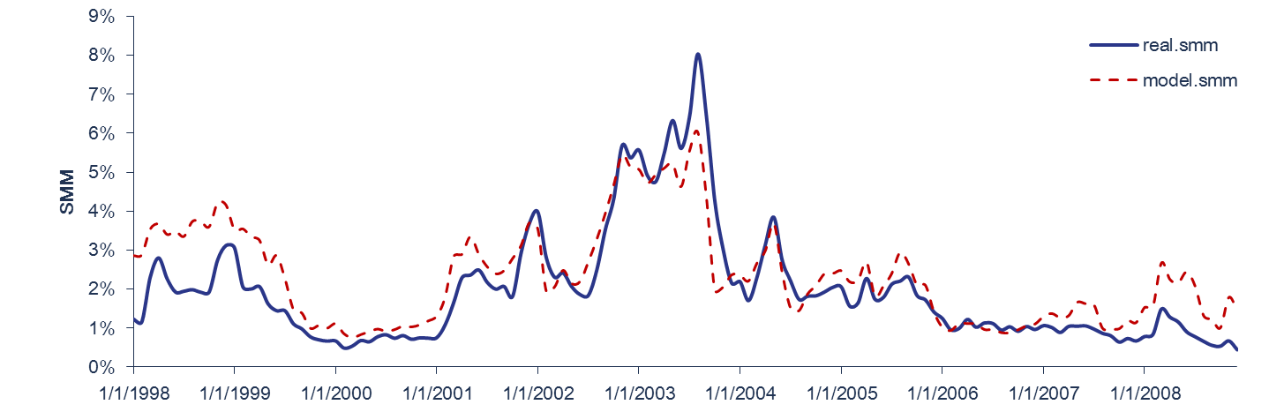
Result After Spline Interpolation
Result shows that model can capture trends over time. However, the model smm is too fast in 1998-1999, too slow in 2003-2004, and too fast for recent data. In order to improve the fit, media effect and credit availability multipliers are introduced.
Slower
Faster
Faster
Mean contribution
3%
4%
26%
68%

Slide 15
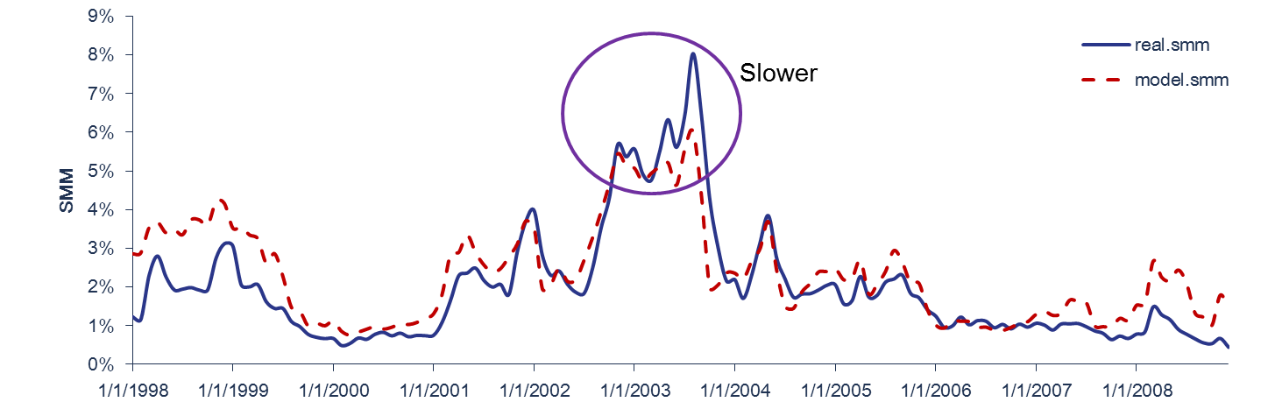
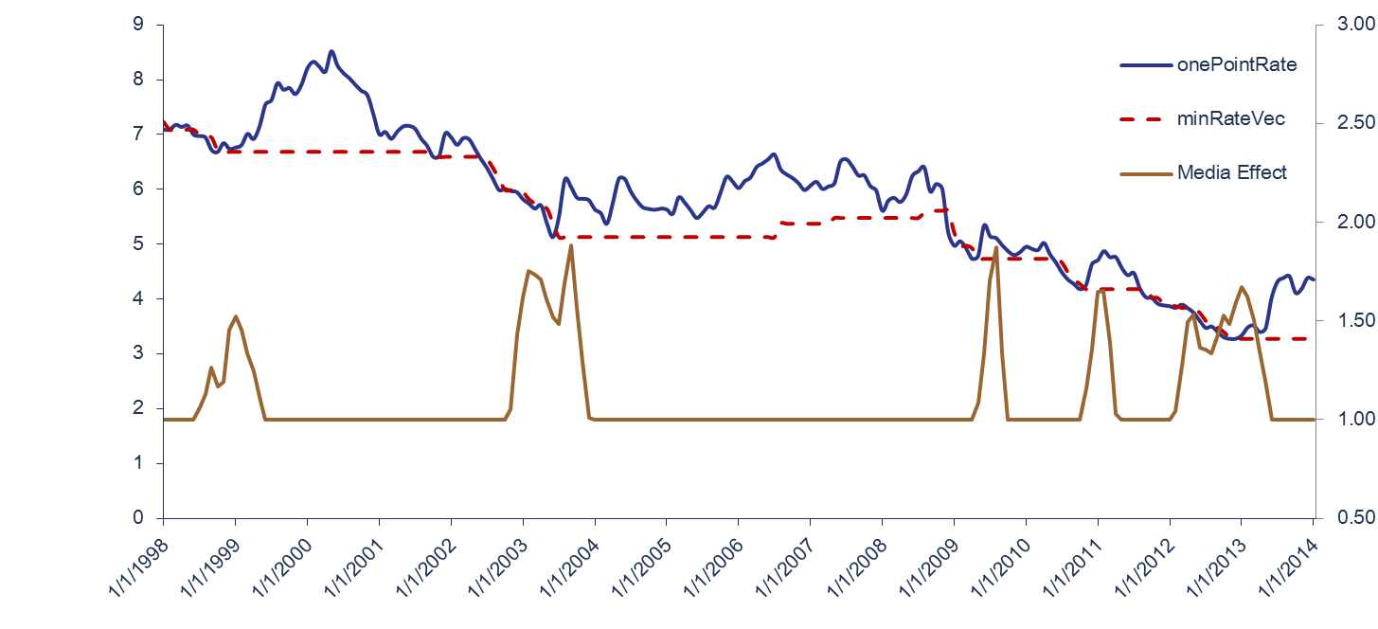
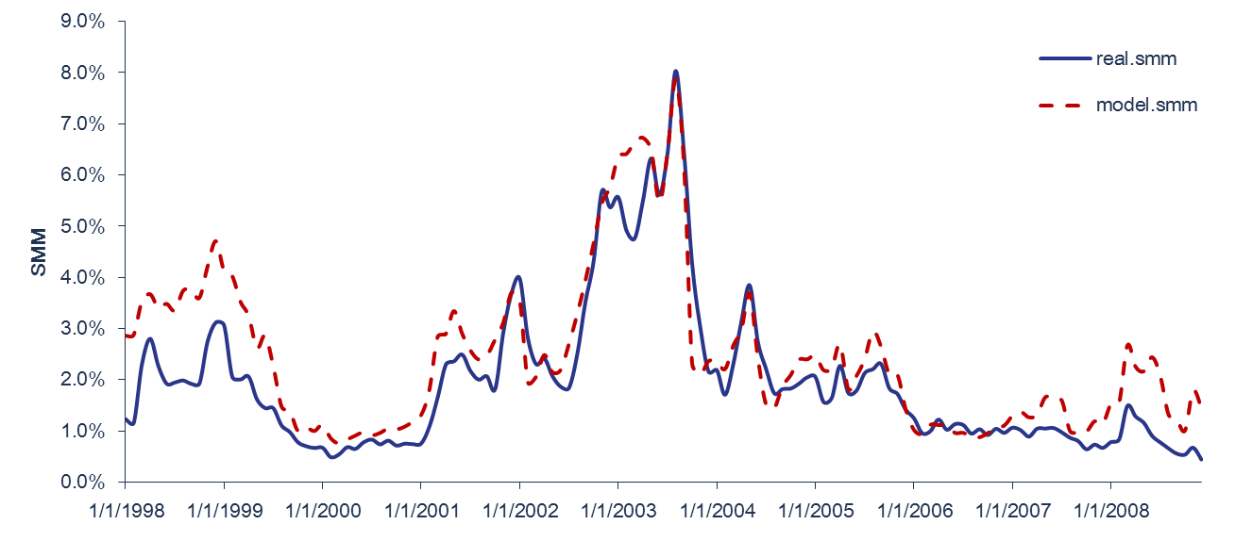
Media Effect and Credit Availability
Media Effect – Meet the Refinance Wave
Mortgage borrowers tend to refinance more aggressively than usual when rates hit multi-year lows.
Model prepay speed is slower in 2003
Reason:
Media effect
Solution:
Media effect multiplier
Result:
Meet Refi Wave 2013
DeltaPMMS30 = max(lowest PMMS in past 3 years not including this month - PMMS this month + rate buffer, 0)
DeltaPMMS30_MA = 3-month moving average of DeltaPMMS30.
Media effect multiplier = max(5 * DeltaPMMS30_MA at three month earlier, 1.0)
Rate Changes and Media Effect
Fitting Result after Media Effect

Slide 16
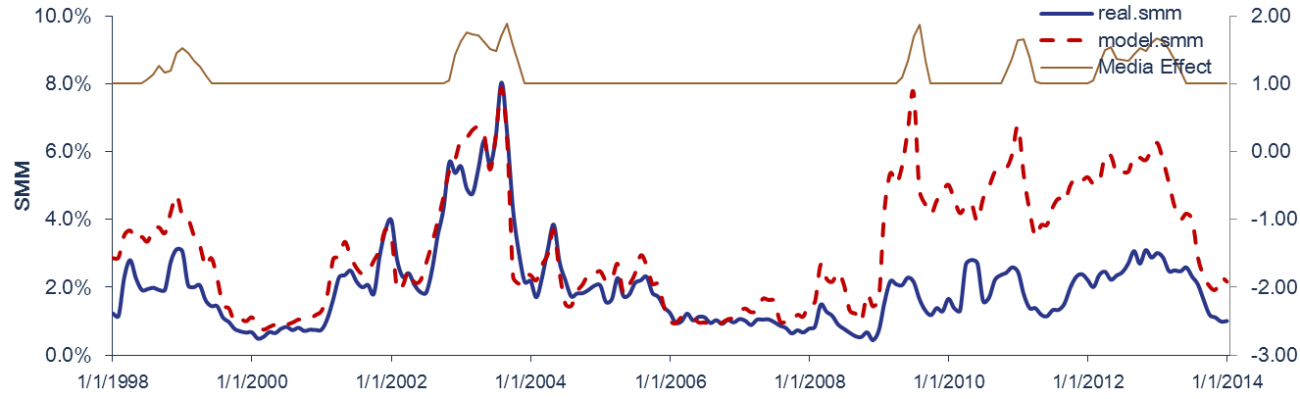
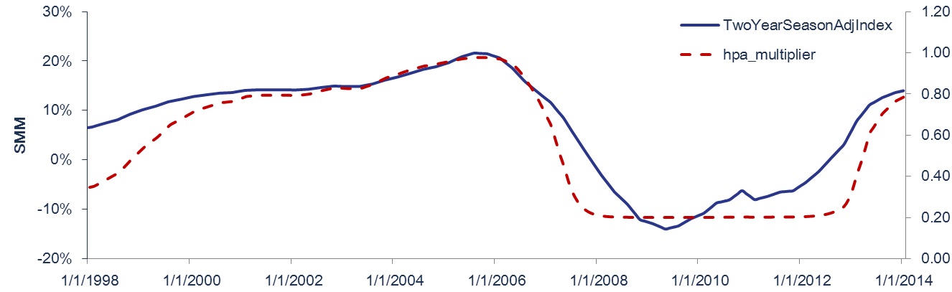
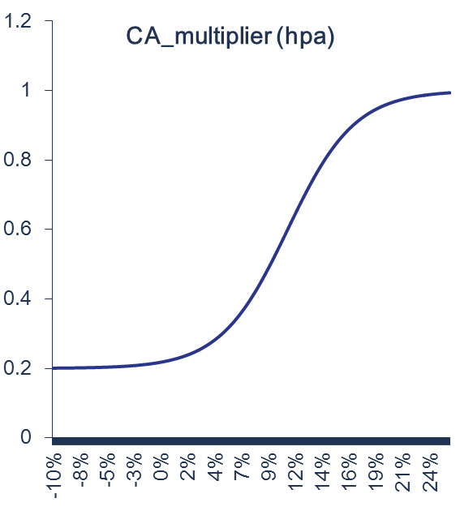
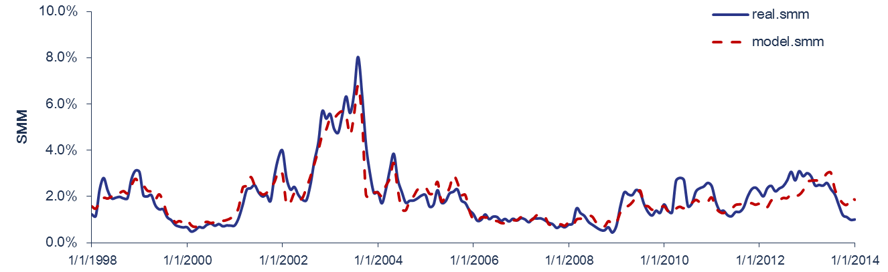

Media Effect and Credit Availability
Credit Availability
Model SMM is too fast after 2008
Using same Media Effect model
Another factor need to be involved for the house market.
$$CA=1− α/(1 +e^((hpa2yr − β)/γ)$$
Good overall fitting result from 1998 to 2014

Slide 17
Monotonic Spline Function Media Effect “Jump Up” Problem Change Credit Availability Efficient R- Script
Improvement

Slide 18
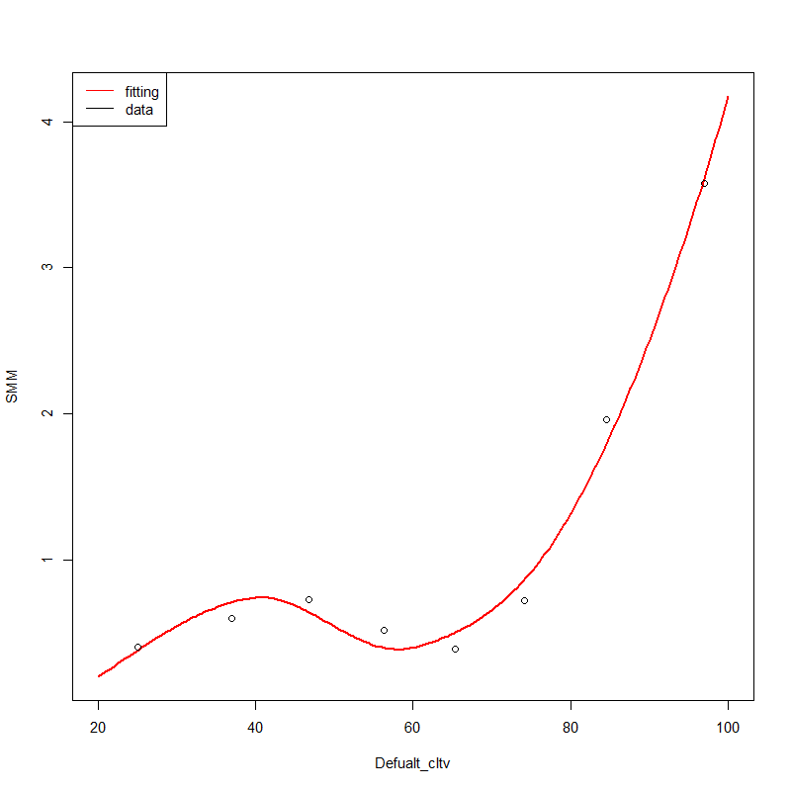
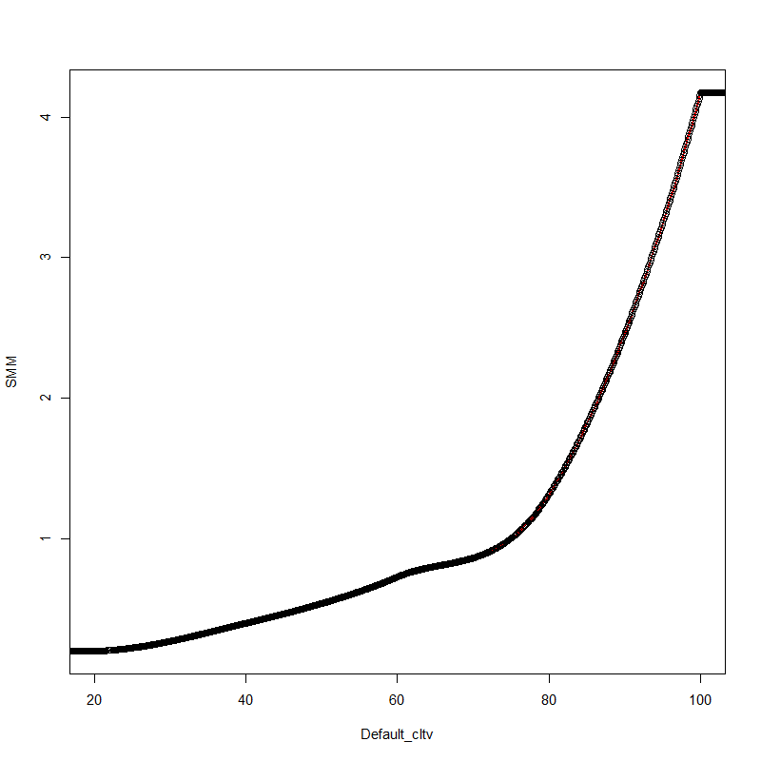
Model Improvements I Change smooth spline to monotonic Hermite spline
Cubic Spline
smooth.spline
Derivative discontinuous when use few knots
natural spline
First derivative continuous, poor local control, no monotonic feature
Hermite spline
First derivative continuous, piecewise cubic strong local control,
monotonic feature
Previous
First derivative continuous
Monotonic
Change Hermite spline, re-check the raw data, fulfill monotonic condition.

Slide 19
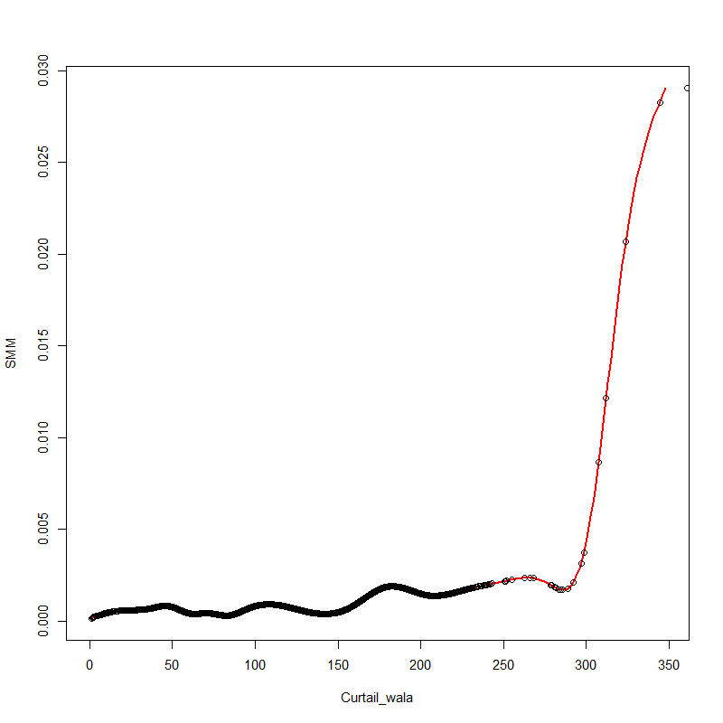
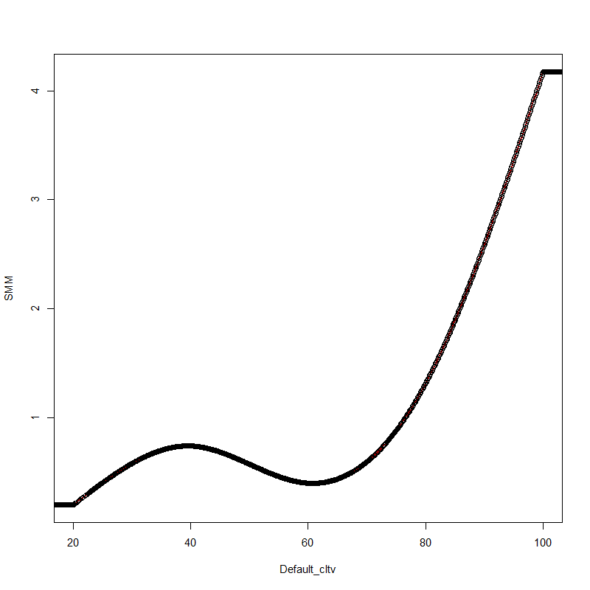
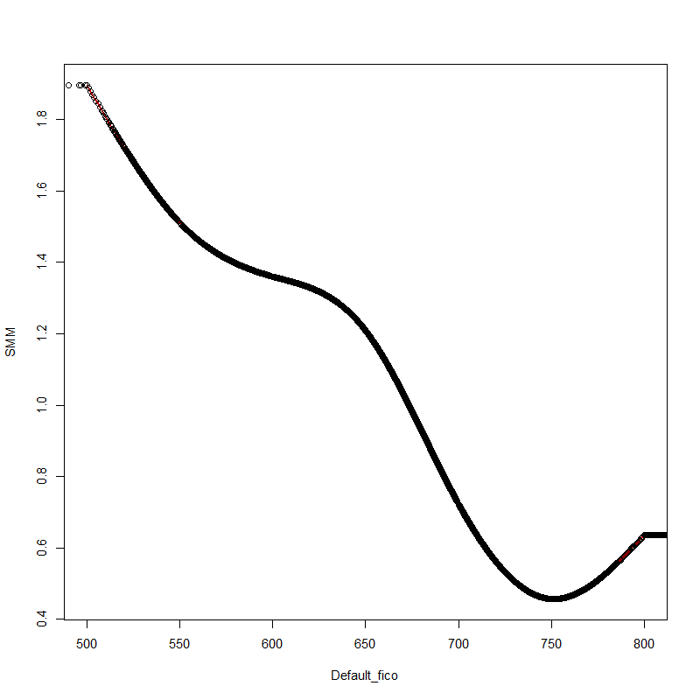
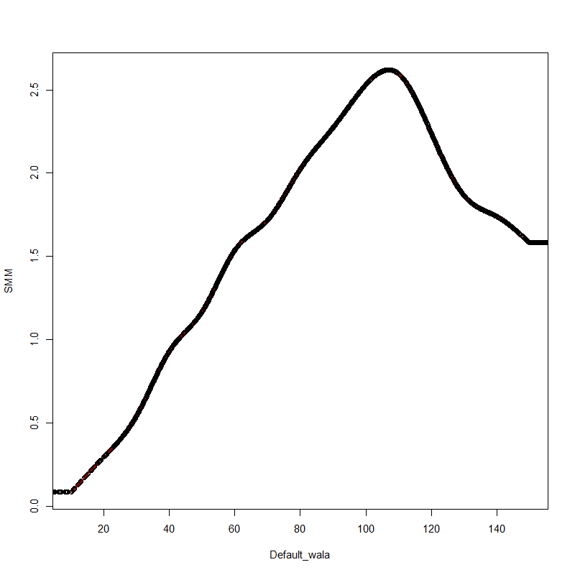
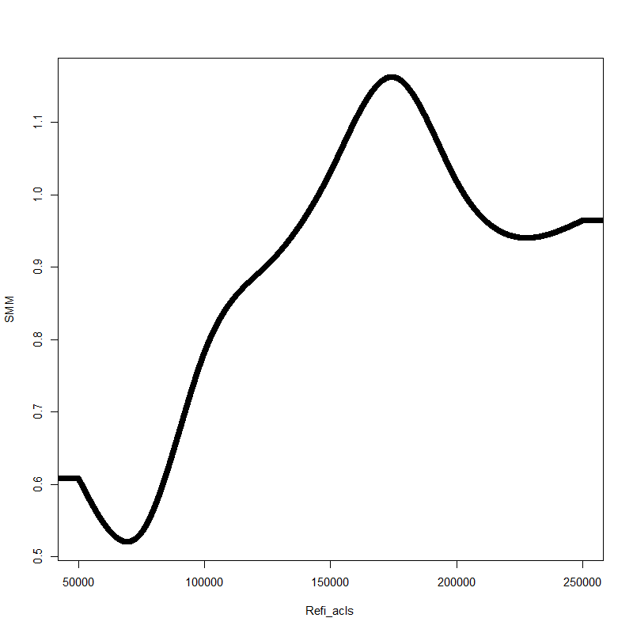
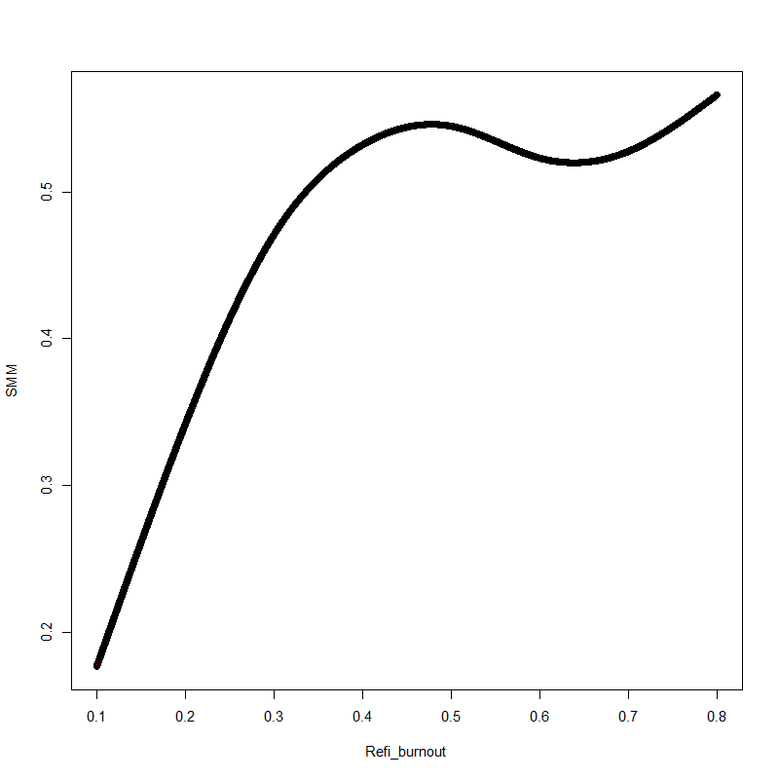
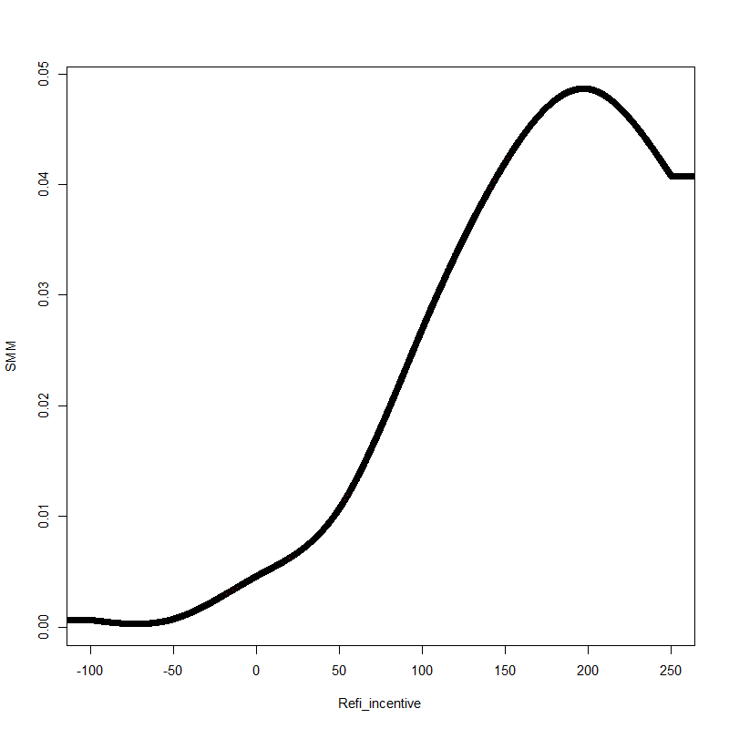
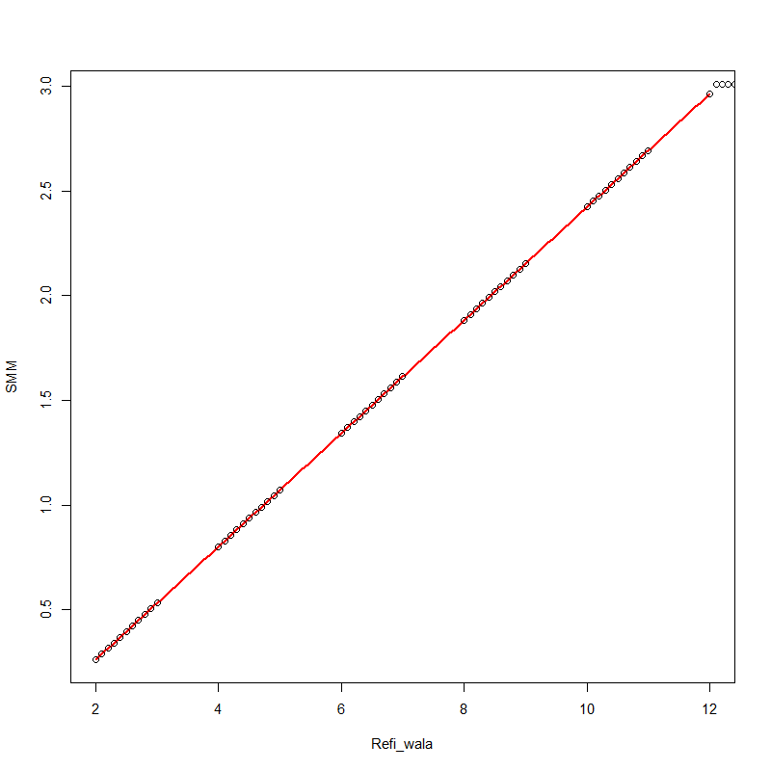
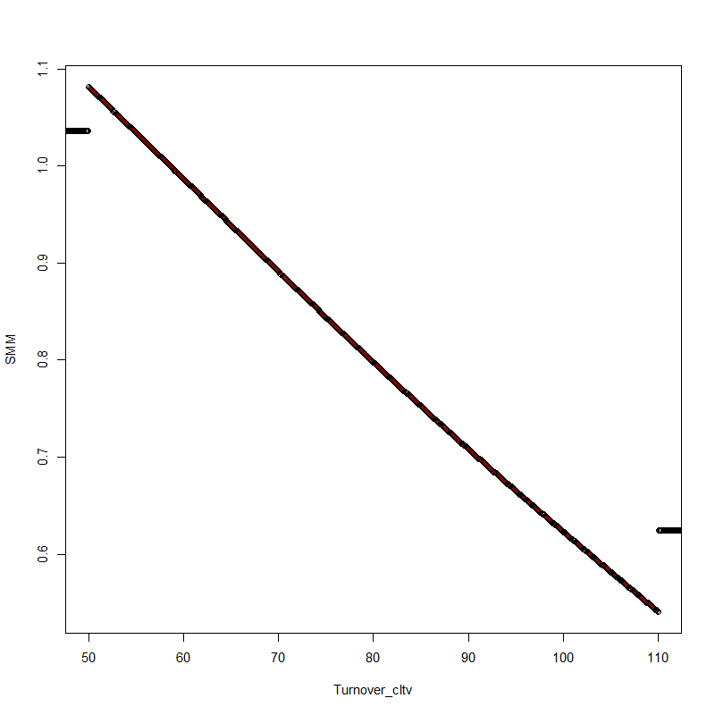
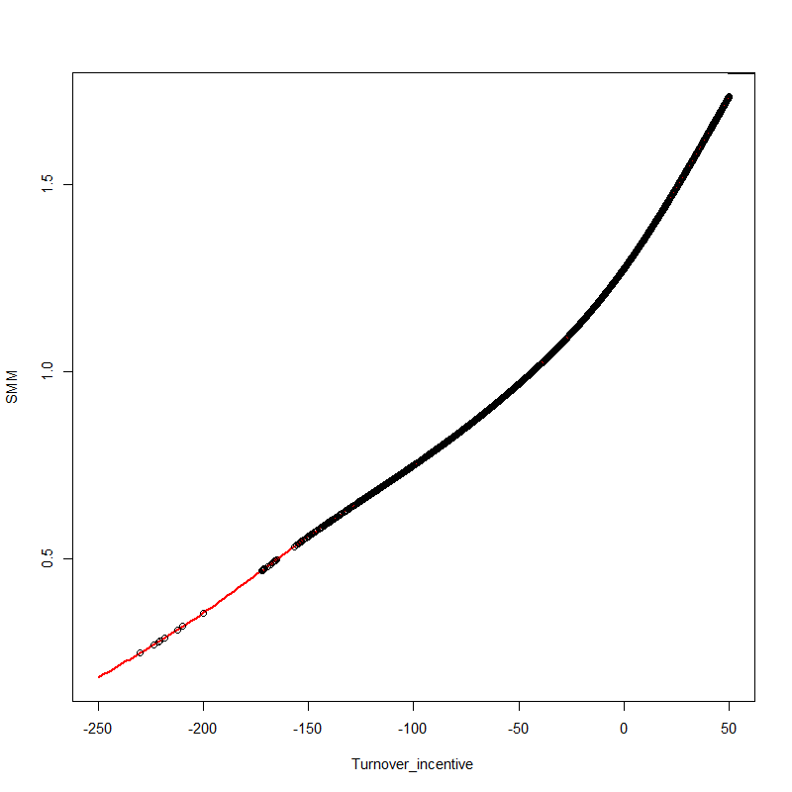
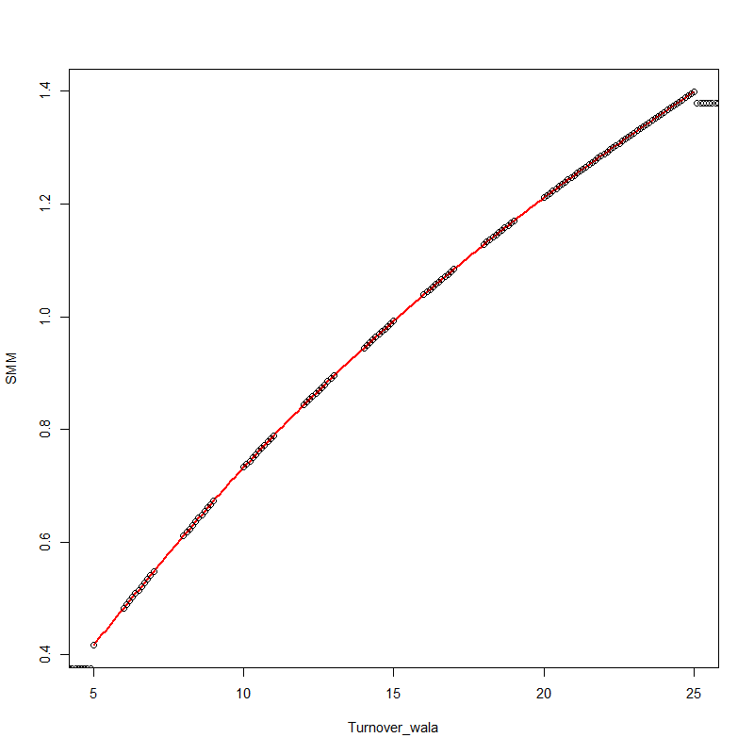
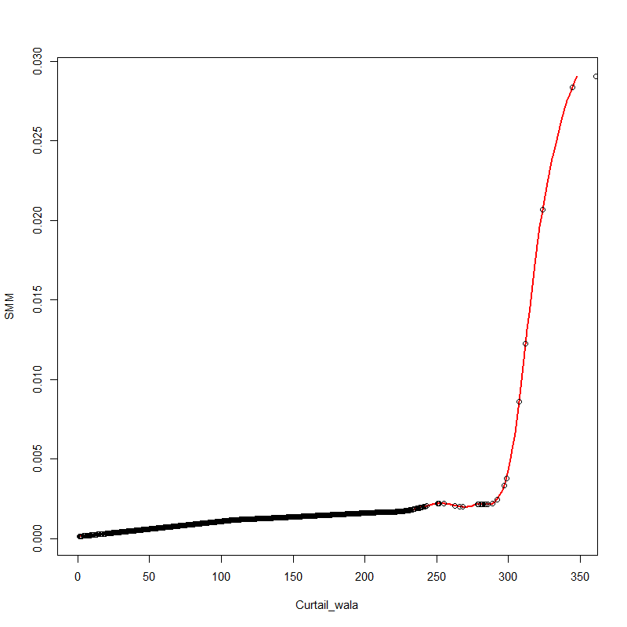
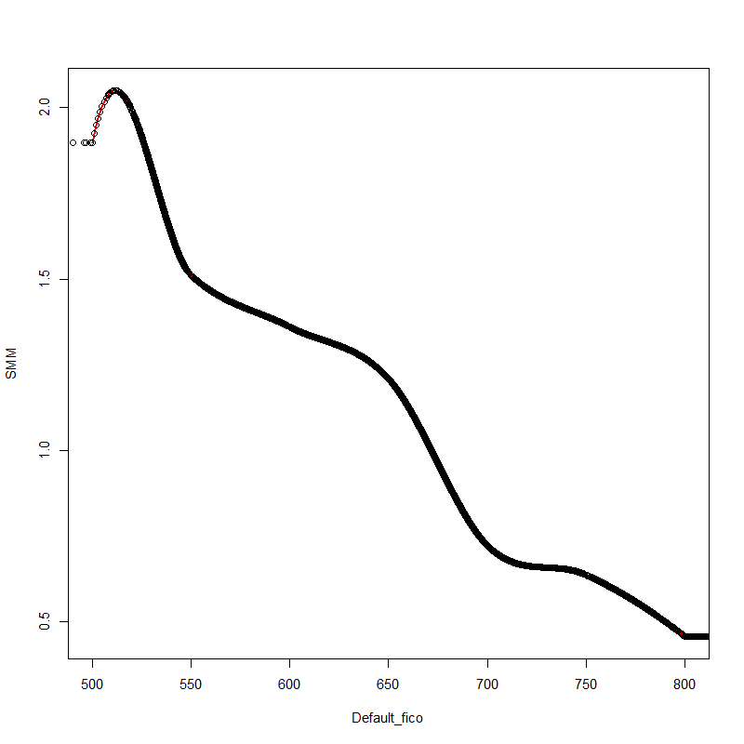
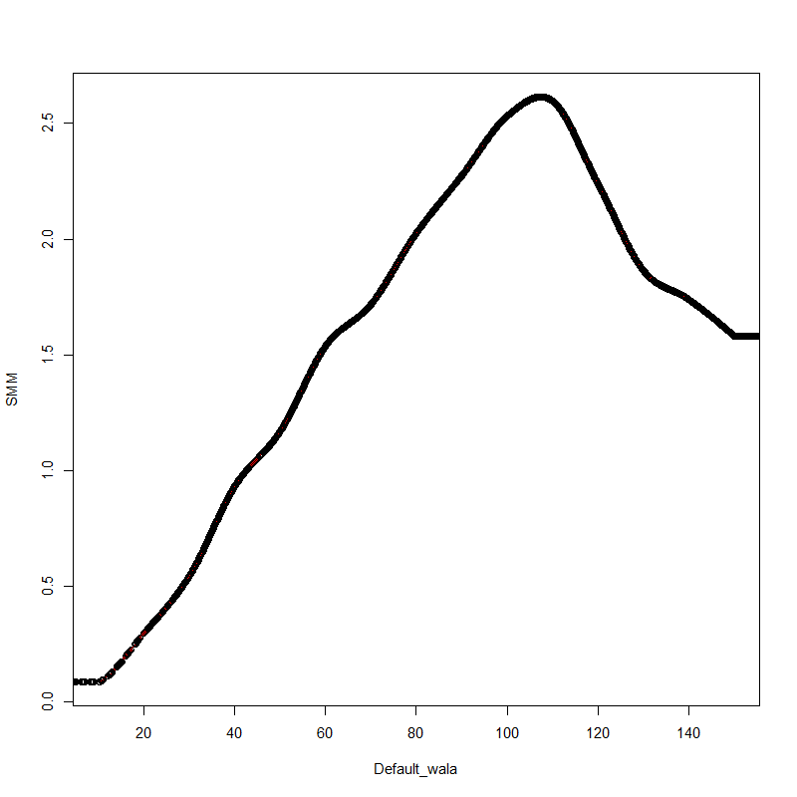
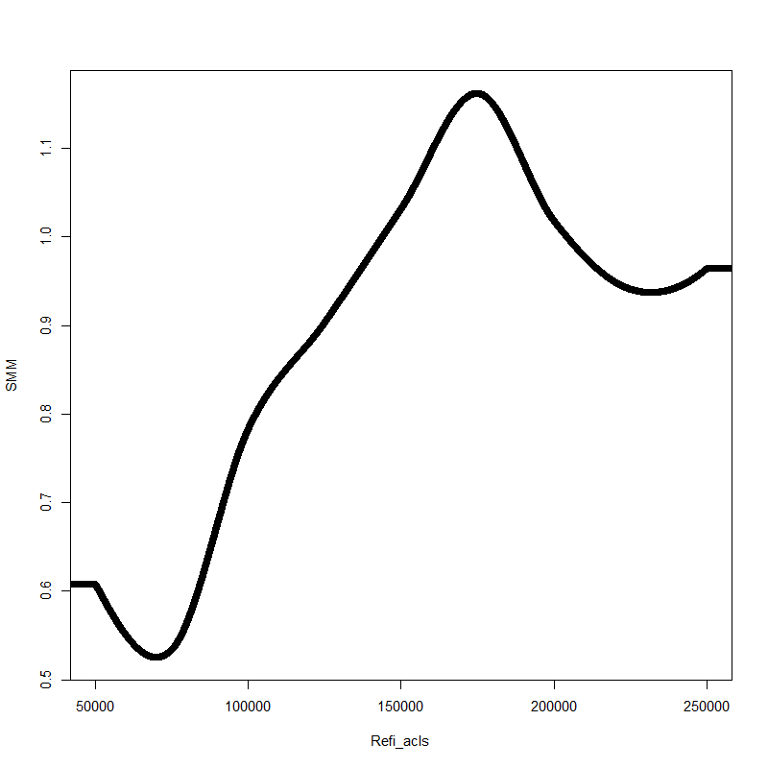
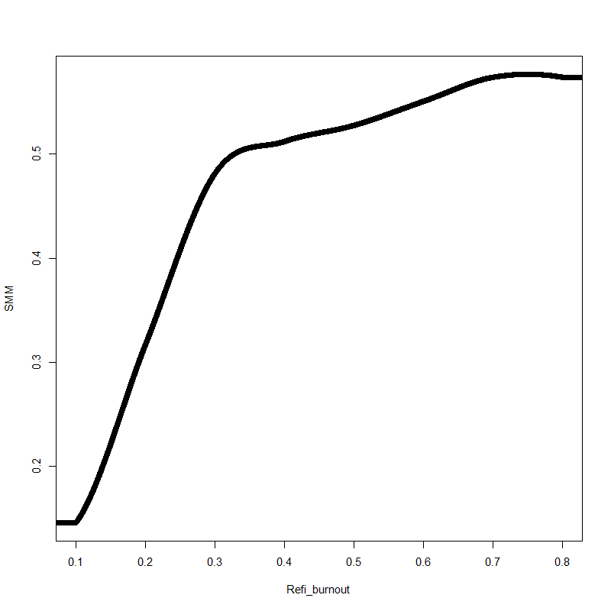
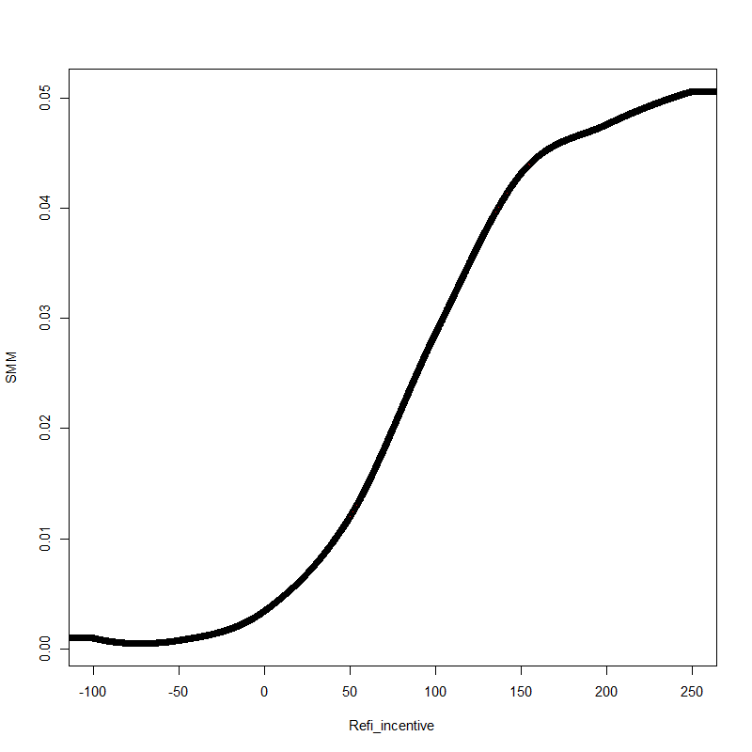
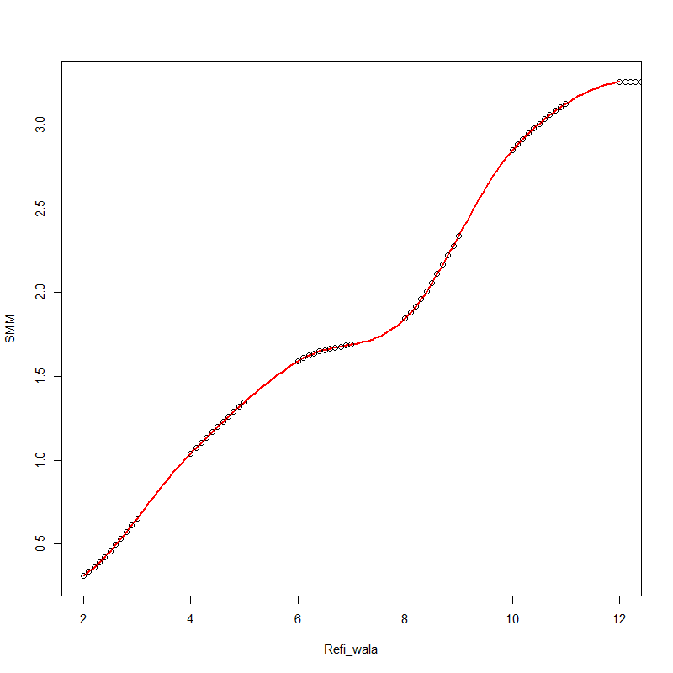
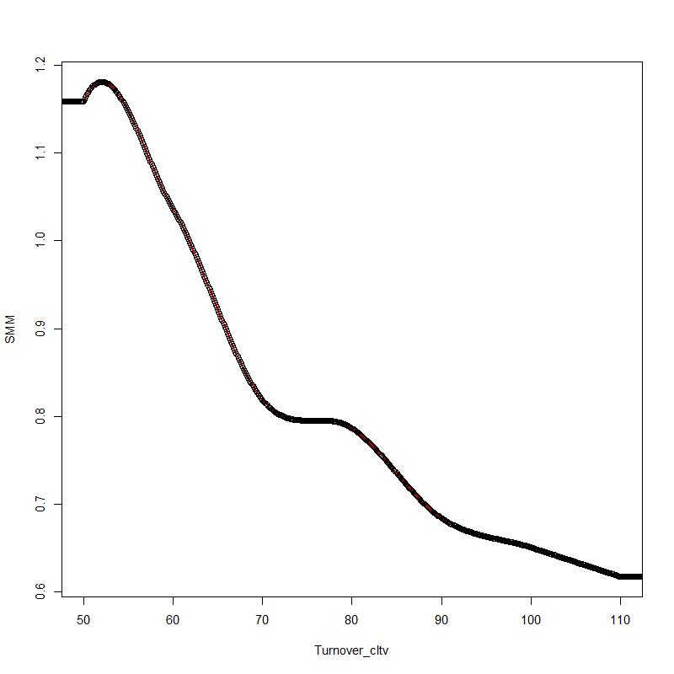
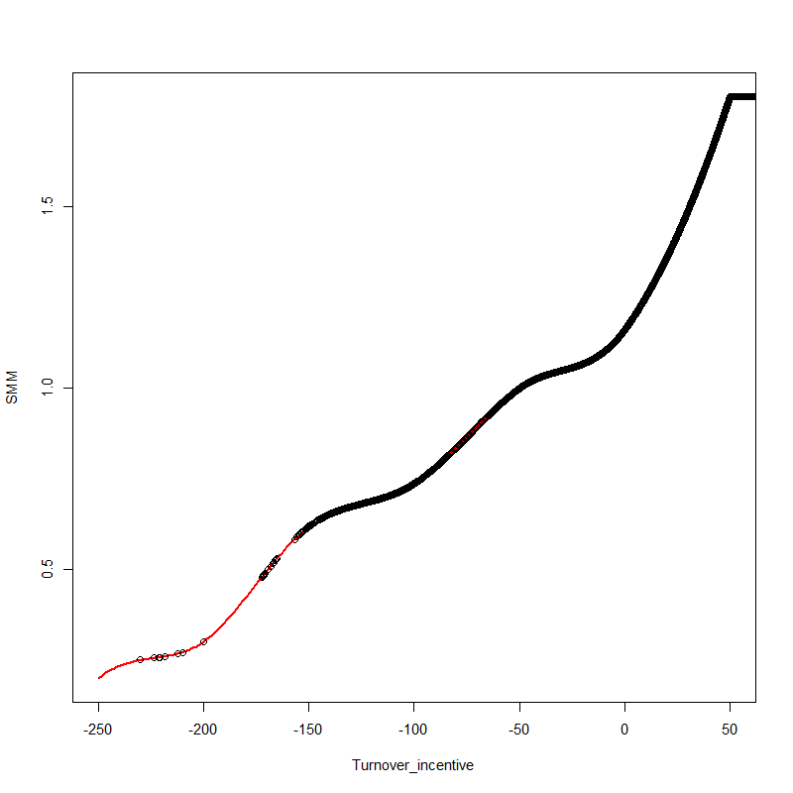
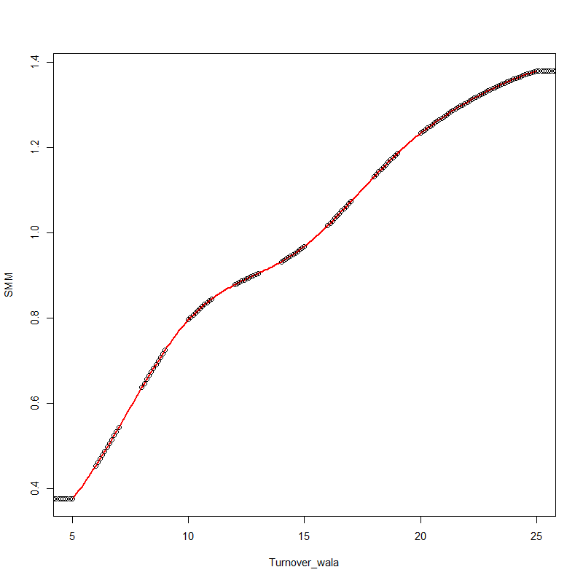
Model Improvements I Change smooth spline to monotonic Hermite spline
Before
Curtail_wala
Default_cltv
Default_fico
Default_wala
Refi_acls
Refi_burnout
Refi_incentive
Refi_wala
Turnover_cltv
Turnover_incentive
Turnover_wala
After
Curtail_wala
Default_cltv
Default_fico
Default_wala
Refi_acls
Refi_burnout
Refi_incentive
Refi_wala
Turnover_cltv
Turnover_incentive
Turnover_wala

Slide 20
Model Improvements II Remove “jump up” problem in media effect
Consider a situation when rate stay constant for 3 years
=rate adj
=0
DeltaPMMS30 = max(lowest PMMS in past 3 years not including this month - PMMS this month + rate adjust, 0)
DeltaPMMS30_MA = 3-month moving average of DeltaPMMS30.
Media effect multiplier = max(5 * DeltaPMMS30_MA at three month earlier, 1.0)
=5 * rate adj
If (5 * rate buffer) > 1, Media effect multiplier will unexpectedly jump up
Solution: set rate adjustment boundary no larger than 0.2
Check fitting error:
 | Rate Adjustment | Fitting Error
Previous buffer | 0.25 | 0.673184642
New buffer | 0.2 | 0.666360687
Min error | 0.2301195 | 0.651605852

Slide 21
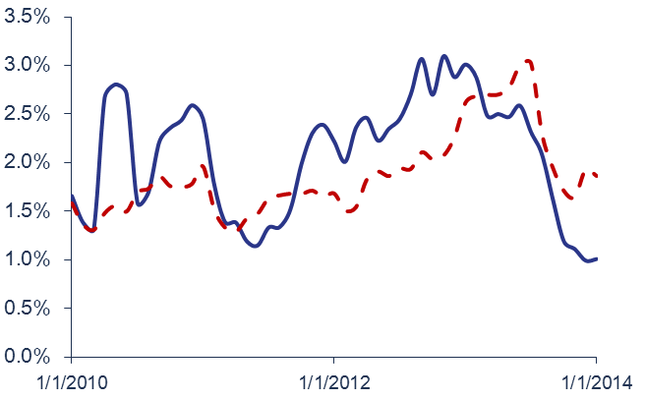
Model Improvements III Change Credit Availability measure, Improve Recent Years Fitting
Fitting Quality Decrease After 2010
0.9% fitting error
Overall fitting result is acceptable, but resent years results show a larger error.
Error in 2004 even increase to 0.9% SMM.
Review HPA Model
HPA measure shows a higher prediction SMM in recent 2 yrs.
More strict underwriting criteria
Need to find a credit availability measure with thin tail

Slide 22
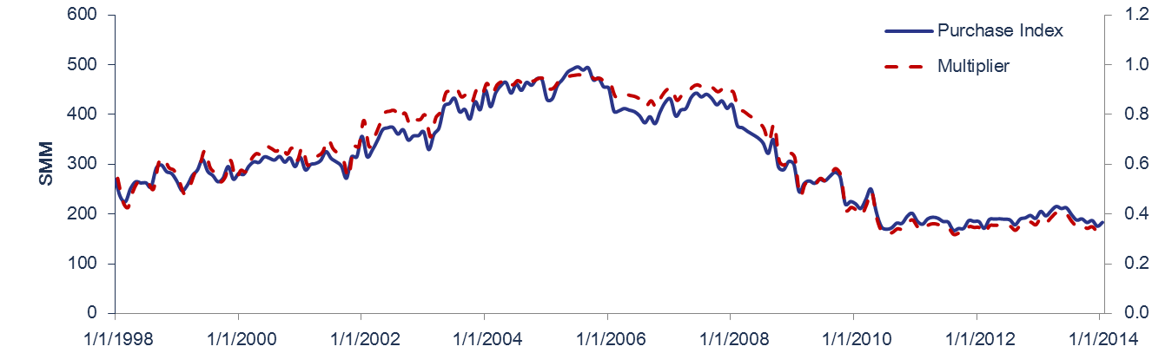
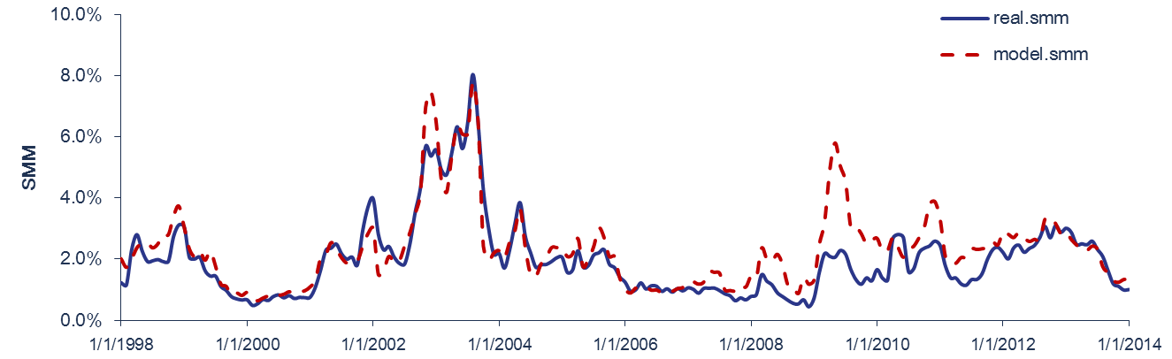
Model Improvements III Change Credit Availability measure, Improve Recent Years Fitting
Purchase Index
Changed credit availability
Using MBAVPRCH Purchase Index instead of HPA
$$CA=1− α/(1 +e^((purchase − β)/γ)$$
Get a right model shape: thin tail in recent 2 years
Problem:
Purchase index is sensitive to mortgage rate.
Multiplier decrease slow in 09’ to 10’.

Slide 23
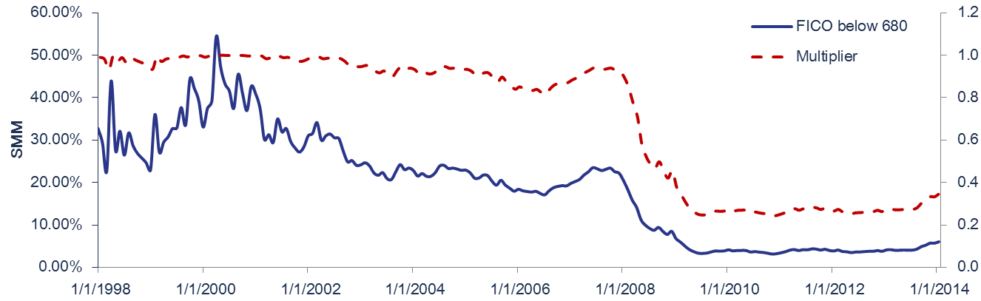
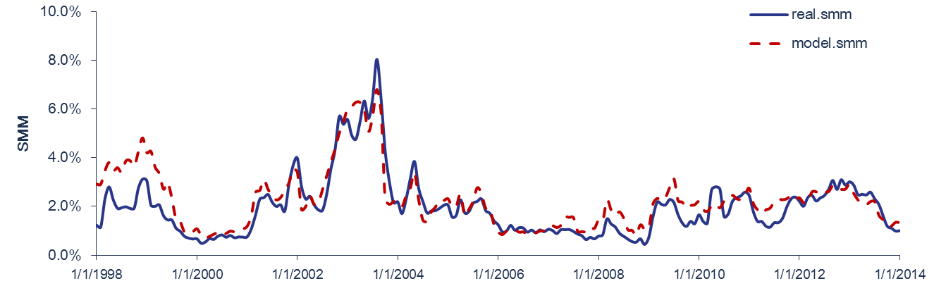
Model Improvements III Change Credit Availability measure, Improve Recent Years Fitting
FICO Distribution Measure
Borrowers in purchase activities is sensitive to mortgage rate, so using purchase index to directly measure credit availability may brings bias.
Consider another measure: percentage distribution of FICO score
e.g.: Percentage for borrowers’ FICO below 680 is 22.55% in Nov. 2007;
this number decrease to 3.29% in July 2009.
Get a less rate-sensitive measure for credit availability.
High overall fitting quality;
Errors in recent years keep low.
Average Fitting Error = 0.39% SMM

Slide 24
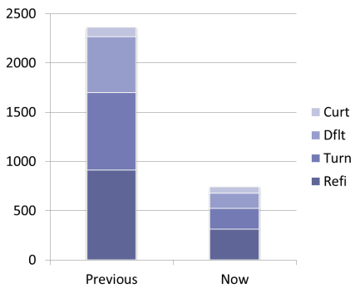
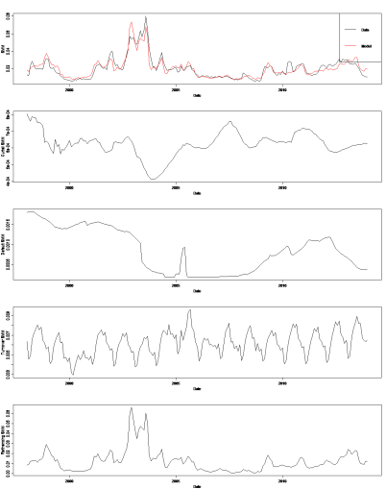
Model Improvements IV Efficient R-Script
Code Efficiency
Made every sub-component/functional calculation process a function:
Refinancing model: reduce from 913 lines to 310 (reduce by 66%)
Turnover model: from 783 to 212 (reduce by 73%)
Default model: from 567 to 156 (reduce by 72%)
Curtailment model: from 98 to 65 (reduce by 34%)
Total reduce: from 2361 to 743 (reduce by 68.5%)
Remove manual execution: only need to call one function for each component
easy to add/delete factors in sub-model
easy to change functional calculation method
Remove most loop calculation: Loop in R is the most time consuming part
change loops with matrix function
New Features
Visualize the quality of sub-model fitting across various prepayment data.
Building spline function:
Includes 3 different spline function, easy to choose:
Smooth spline
Natural spline
Hermite spline

Slide 25
Version Review
R Script Folder | Description | Final Changed Date
ppmRCode_1.2 | Bin's latest version
ppmRCode_1.2.1 | Previous Version: ppmRCode_1.2; Bug fixed: manual copy wrong parameters; finished the 2nd time spline optimization using least square optimal results. | 7/9/2014
ppmRCode_1.3 | Previous Version: ppmRCode_1.2.1; make every fitting and tracking components a function, easy to add or delete factors; reduce loop calculations; Provide same result as folder ppmRCode_1.2.1. local storage raw data and calculation data, easy to track; | 7/17/2014
ppmRCode_1.3.1 | Previous Version: ppmRCode_1.3; Change spline function(from smooth to hermite) for tracking function; Research on media effect and credit availability. | 8/6/2014
ppmRCode_1.3.1/ME1 | Check the model without media effect and HPA
ppmRCode_1.3.1/ME2 | Changed Media Effect parameters, removed "jump up" problem after 3 yrs constant rate
ppmRCode_1.3.1/ME3 | Changed credit availability by modify HPA parameters. HPA measure shows a higher prediction smm than actual in recent 2 yrs. Due to much more strict underwriting criteria, we might need to find a credit availability measure other than HPA.
ppmRCode_1.3.1/ME4 | Changed credit availability, get a right model shape by using Purchase Index instead of HPA, though MBAVPRCH index is sensitive to mortgage rate.
ppmRCode_1.3.1/ME5 | Changed credit availability, get a less rate-sensitive measure for credit availability by constructing a distribution of FICO score in all purchases.
ppmRCode_1.3.2 | Previous Version: ppmRCode_1.3.1; Changed the Pool level model to add a feature to fit the single pool AE5463; Tie out with C++ program result from CCMPrepayModel_v1.2.2. | 8/6/2014
ppmRCode_1.3.3 | Previous Version: ppmRCode_1.3.2; Test version for pool: MA1291 (Fannie Mae) CLTV>100, turnover SMM shows negtive number in C++ v1.2.2 and v1.2; turn is higher in 1.2.1. | 8/8/2014
ppmRCode_1.4 | Previous Version: ppmRCode_1.3.1; Changed the spline function from smooth spline to Hermite cubic spline in fitting; plot all the tracking curves and fitting curves; remove "*0.5" multiplier in default model fico factor . | 7/31/2014
ppmRCode_1.5 | Previous Version: ppmRCode_1.4; Modified knot values to fulfill the conditions for monotonic spline. | 8/4/2014
ppmRCode_1.5/ME5 | Changed credit availability for new refi data generated from new spline function

Slide 26
CONTACT INFORMATION For further information, please contact:
Thank You:
Sharad Chaudhary, Bin Shao, Derek Ho, Chun-nip Lee
&
Cello

